Slide 1
Accessibility Unlocked: Enhancing Web Usability with AXE DevTools and LLMs
Ramesh Kumar Bacchu
Tanishq Motupalli
Abhinav Varma Lakmaraju

Slide 2


Introduction
Objective: Identify and categorize accessibility issues in web-archived data using AXE DevTools & Trove & Wave , with insights from blind users on improving accessibility through conversational AI and Large Language Models (LLMs).
Context: Web accessibility is crucial for inclusivity and legal compliance. Blind individuals often face significant challenges when navigating web archives. Ensuring accessibility is key to providing equal access to information.
Importance: Accessibility improves the user experience for everyone, especially those with disabilities. This project addresses accessibility gaps and explores new solutions for blind users navigating archived content

Slide 3
Implementation Overview
Project Purpose:
Analyze archived websites for accessibility issues and explore how conversational AI and LLMs can assist blind users in accessing archived content.
Unique Aspects:
-> Combination of automated accessibility testing with insights from blind users.
-> Use of Large Language Models to enhance accessibility for blind individuals.
Technologies and Tools:
-> AXE DevTools Chrome Extension for accessibility testing.
->JSON data format for structured analysis
->AI Transcribe.
Methodology:
-> Categorized websites into 24 distinct categories with 50 websites each.
->Conducted a user study with 14 blind participants to gather insights on LLMs and accessibility needs.
->Generated over 27,000 JSON files documenting accessibility issues in archived websites.

Slide 4
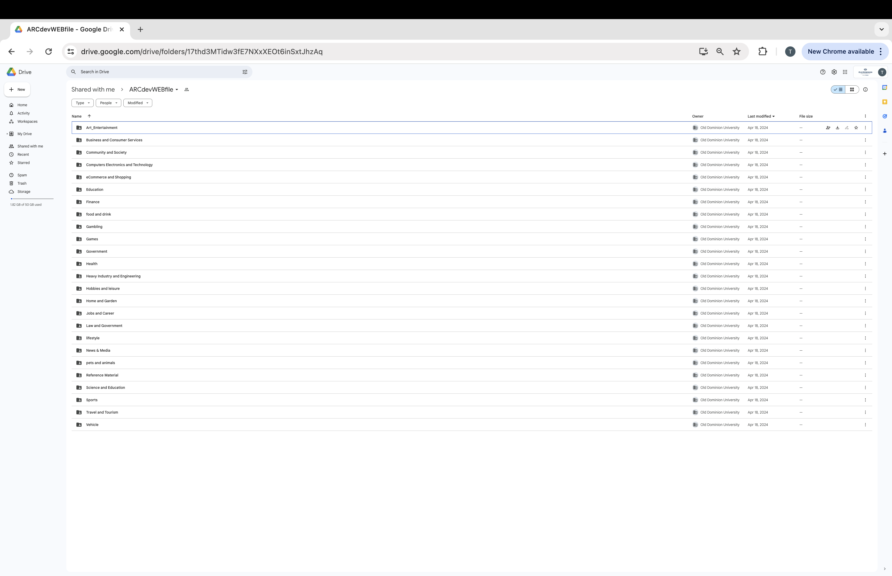
Demonstration (Accessibility Analysis)
Accessibility Testing:
Used AXE DevTools to generate accessibility reports for archived websites.
Common issues identified: Missing alternative text for images, inaccessible forms/buttons, low color contrast, keyboard navigation issues, inconsistent semantic HTML.
Organized data into categories for analysis and comparison.
Data Organization:
Systematically renamed JSON files by category and year for easy analysis.
Addressed challenges with loading times and compatibility in older websites.

Slide 5
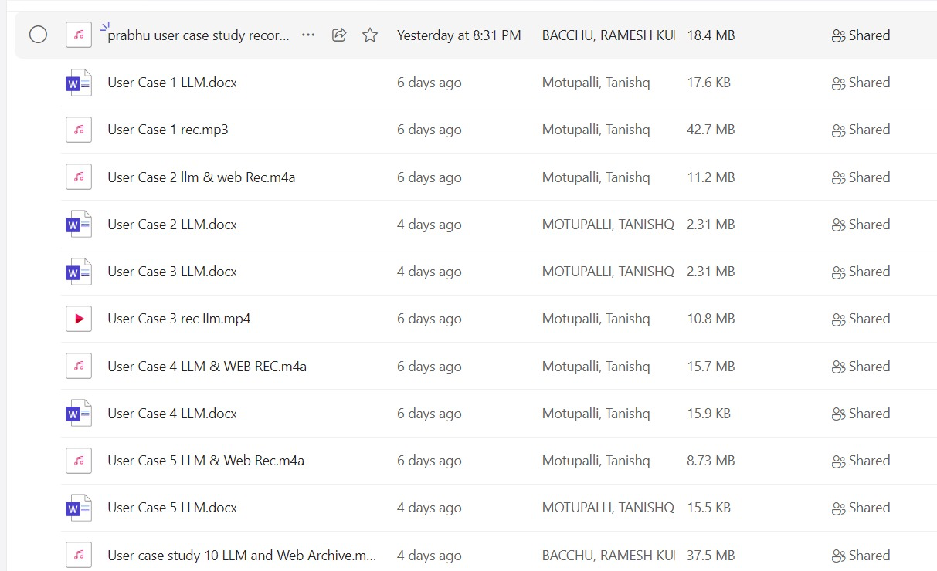
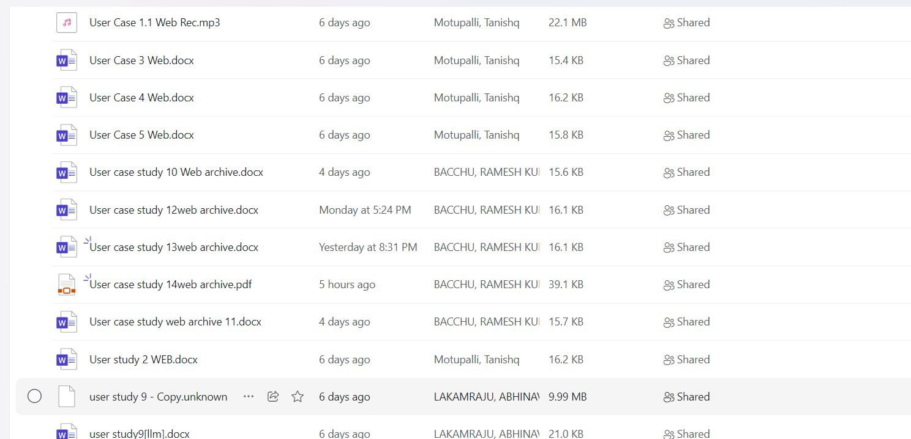
Demonstration (User Study with Blind Participants
Conversational AI and LLMs:
Conducted audio-based interviews with blind users.
Discussed experiences with conversational AI, including trust, human-like qualities, and preferences.
Highlighted key challenges: Inconsistent responses, lack of context, and issues with voice assistants.
Web Archive Navigation:
Explored how blind users navigate archived content with screen readers and voice assistants.
Identified challenges: Outdated information, complex navigation, and missing accessibility features.
Preferred computer-based access over mobile devices for more complex tasks.

Slide 6
Results : Accessibility Analysis and User Study Findings
Accessibility Analysis Results
Common Issues Identified:
Missing Alternative Text: A significant number of archived websites lacked descriptive alt text for images, impacting accessibility for screen readers.
Inaccessible Forms and Buttons: Forms and buttons with unclear labeling or inaccessible design were frequent across categories.
Insufficient Color Contrast: Many websites had low contrast between text and background, affecting readability.
Keyboard Navigation Problems: Issues with tab order and focus indicators were prevalent, complicating navigation for keyboard-only users.
Inconsistent Use of Semantic HTML: Use of non-semantic elements or improper structure made it difficult for assistive technologies to interpret the content.
Variation Across Categories:
Some categories exhibited more accessibility issues than others. For example, "Arts Entertainment" and "Games" had a higher frequency of missing alt text, while "Business and Consumer Services" and "Education" showed more issues with keyboard navigation and semantic structure.

Slide 7
Results : User Study Results: Conversational AI and Web Archive Navigation
Interaction with Conversational AI and LLMs
Limited Experience with Conversational AI:
Most participants had little to no experience with conversational AI systems or LLM-based applications.
Those who used them pointed out inconsistent responses and a lack of context, making it difficult to rely on these systems.
Valued Qualities:
Participants emphasized the need for conversational AI systems to be transparent, reliable, and to exhibit some human-like qualities to establish trust.
Clear and straightforward communication was critical for establishing a positive user experience.
Potential Benefits of LLMs:
Participants believed that LLMs could help with information retrieval, providing navigational assistance, and facilitating social connection.
Web Archive Navigation Challenges
Tools and Technologies Used:
The majority of participants relied on screen readers, with mixed experiences using voice assistants due to their limitations in context interpretation.
Participants preferred accessing past web content using computers over mobile devices for more complex tasks.
Key Challenges:
Outdated Information: Older web content often contained outdated or irrelevant information.
Complex Navigation: The structure of archived websites made it challenging to find specific information.
Missing Accessibility Features: Certain websites lacked basic accessibility features like clear focus indicators or keyboard navigation support.
Preferred Content Types and Devices:
Participants found news articles, blogs, and educational content most valuable when revisiting archived websites.
Desktop environments were preferred for more comprehensive tasks, while mobile devices were used for simpler interactions.

Slide 8
Conclusion and Future Directions
Key Findings and Achievements:
1
Successfully identified a wide range of accessibility issues across archived websites.
Provided valuable insights from blind users on the use of conversational AI and LLMs for accessibility.
Lessons Learned and Challenges Overcome:
2
Addressed issues with accessing older websites and ensuring data accuracy.
Ensured participant privacy and confidentiality during the user study.
Areas for Future Improvement:
3
Extend analysis to live websites for more comprehensive accessibility testing.
Develop LLM-based solutions designed specifically for blind users, integrating voice and screen reader capabilities.
Explore collaboration with accessibility experts and blind user groups to refine solutions.
Potential Impact:
4
By focusing on trust, transparency, and adaptability, LLMs can significantly improve accessibility for blind users.
This project demonstrates the potential for innovative approaches to enhance web accessibility and inclusivity.

Slide 9
Thank You

